Slide 1

Studio Glossary: Women’s Category
WOS
2017

Slide 2
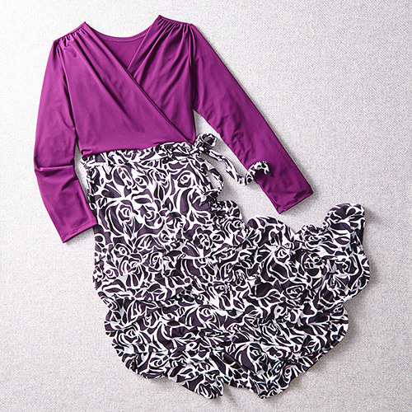
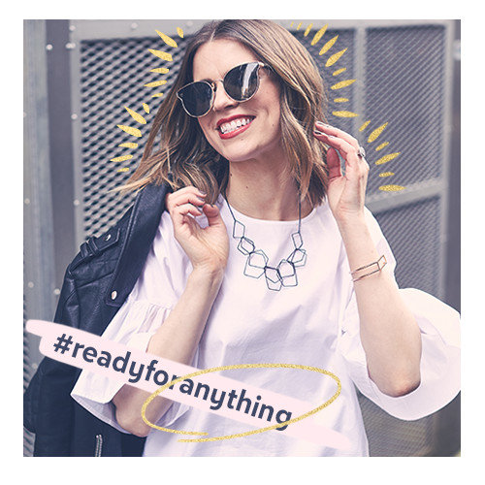
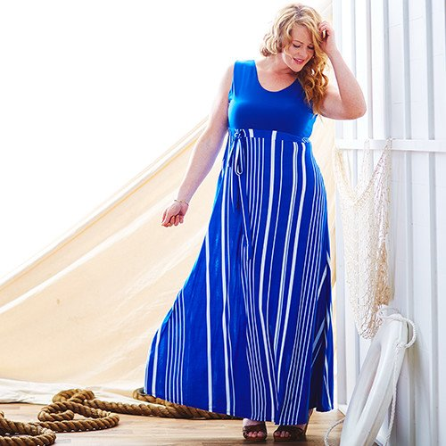
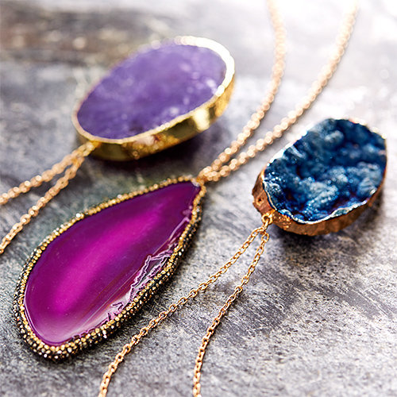
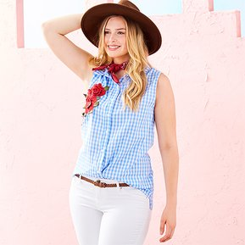
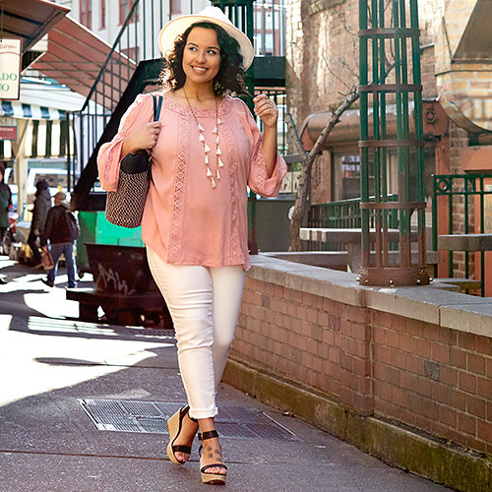
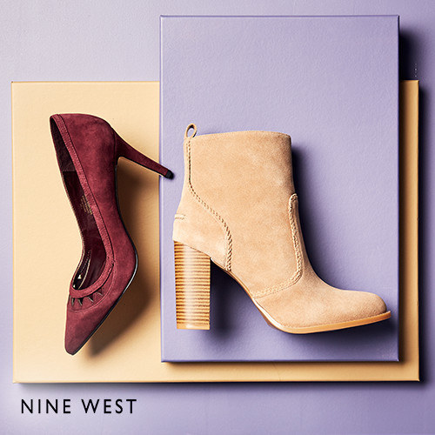
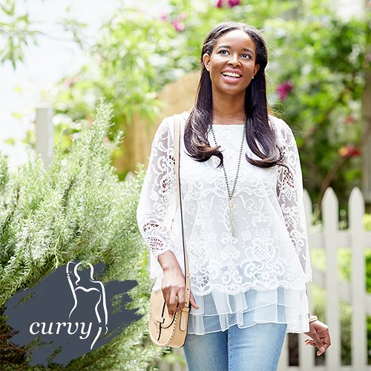
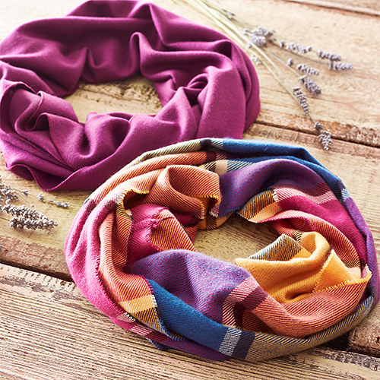
Women’s Department
Studio Glossary: Women’s Category
1
Women’s Category
There are several categories that are frequently requested within the Women’s department:
Boho
Modern
Blogger Style
Western
Preppy
Nautical
Shabby Chic
Feminine / Romantic

Slide 3
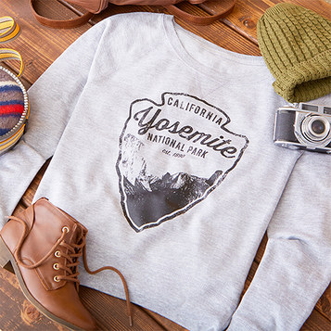
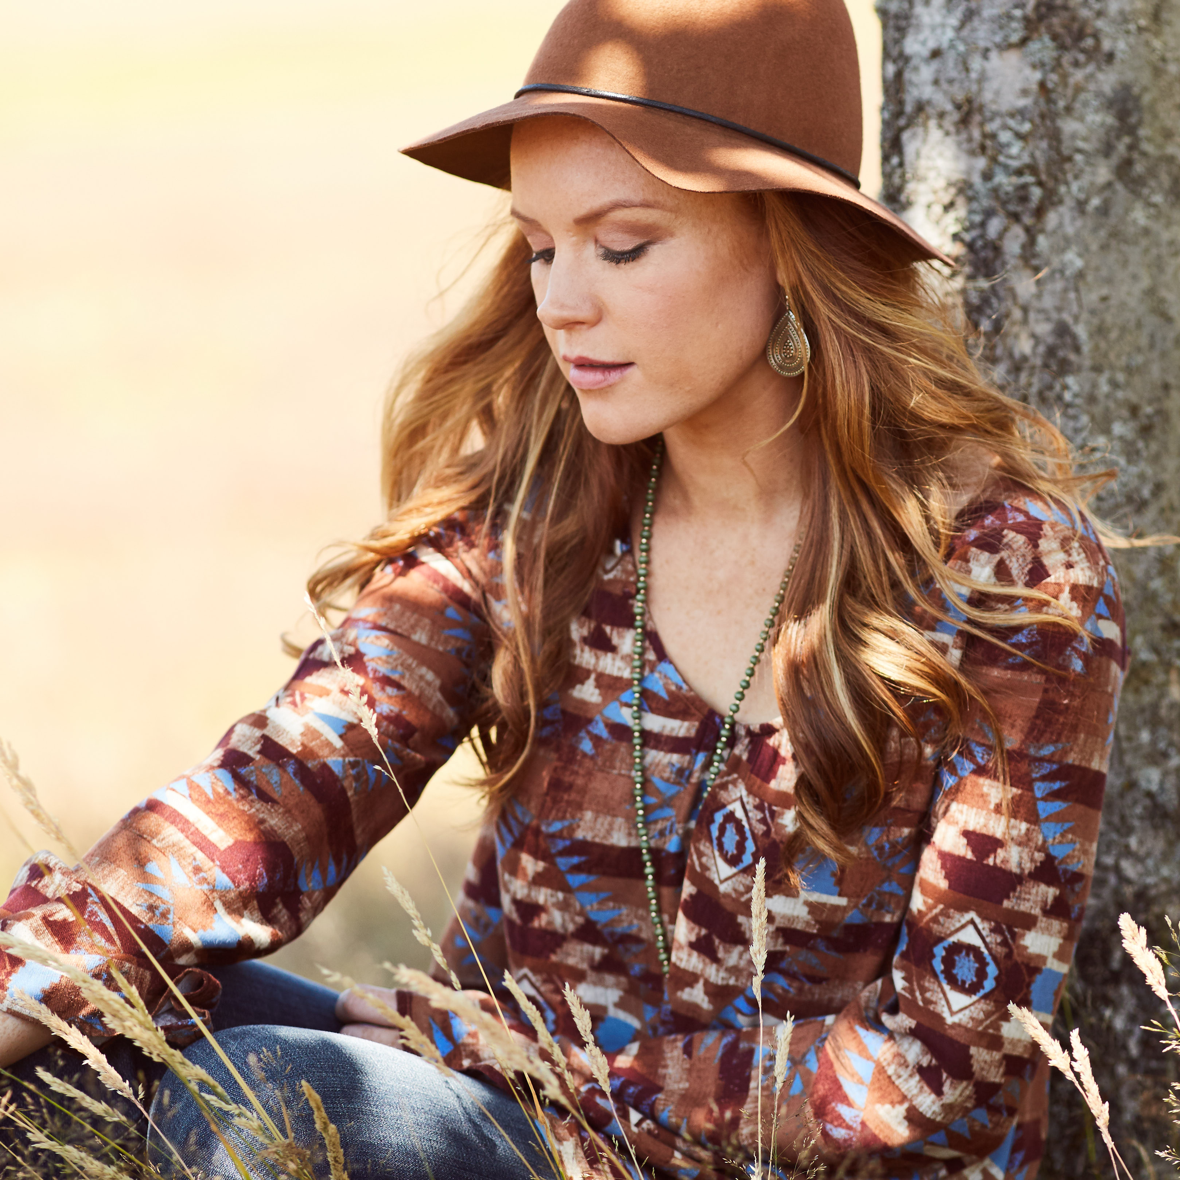
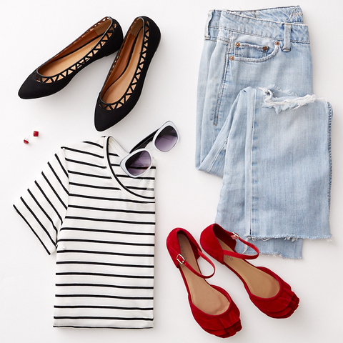
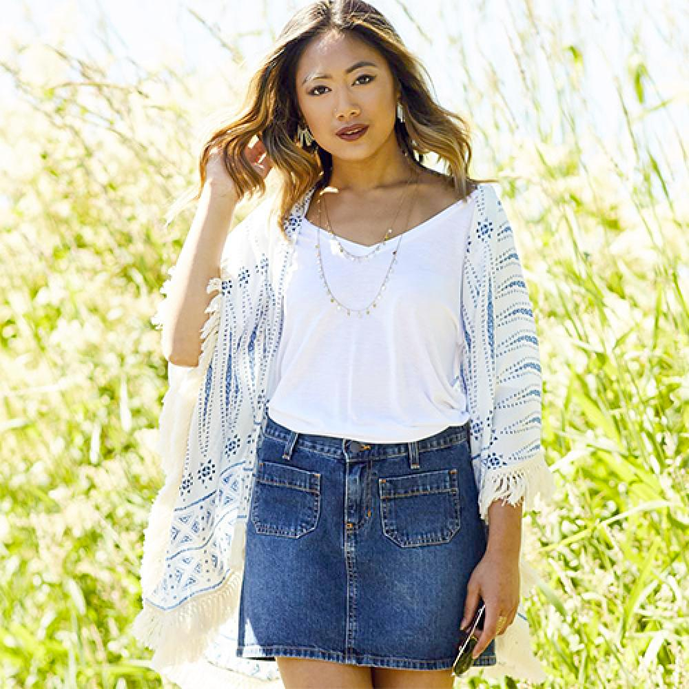
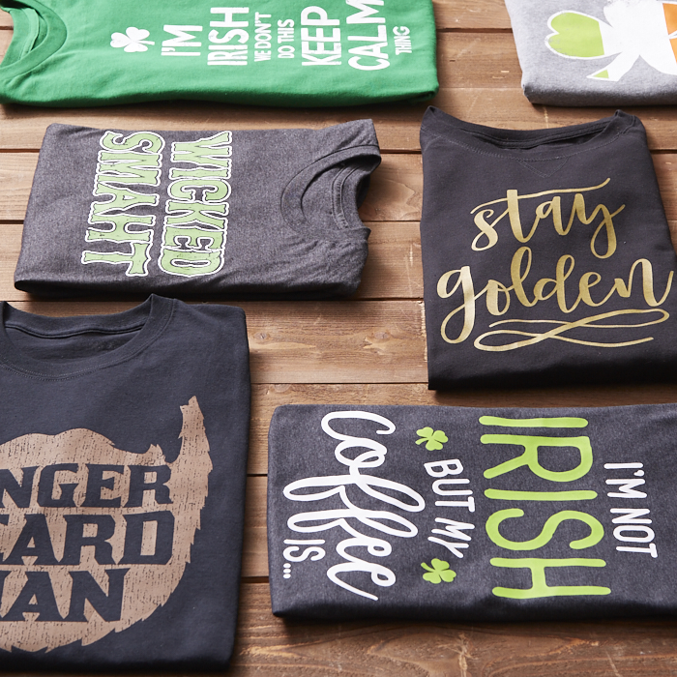
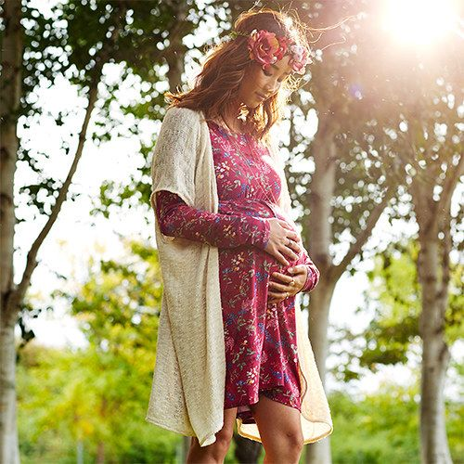
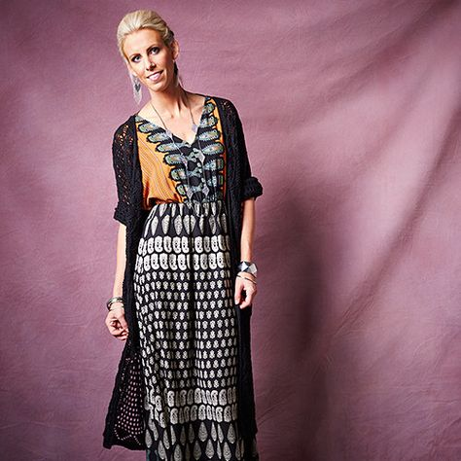
Women’s Department
Studio Glossary: Women’s Category
2
Boho
Boho Definition: Style drawing from bohemian and hippie influences with a gypsy, folky element. Accessories might include: over-accessorizing with bangles, scarves, layered long necklaces, hats, rings, long vests. Possible HMU: braids, tousled waves, smoky eye, highlighter.
Brand Reference: Free People, Anthropologie

Slide 4
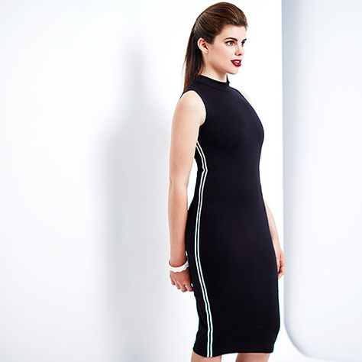
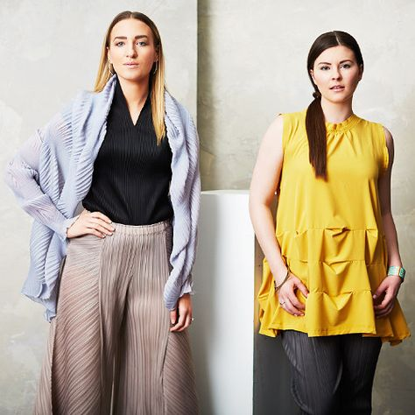

Women’s Department
Studio Glossary: Women’s Category
3
Modern
Modern Definition: Simple, clean lines, minimal; possibly structured, oversized or geometric.
Possible HMU: sleek, straight hair, strong brows, possible statement lip or eye, clean makeup.
Brand Reference: Aritzia, Totokaeio, Eileen Fisher, The Row

Slide 5
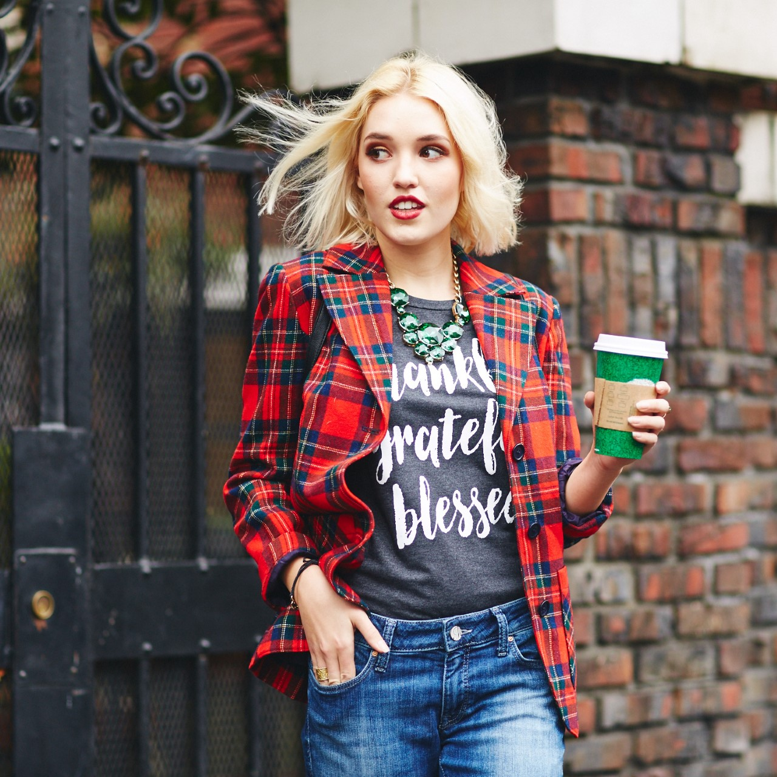
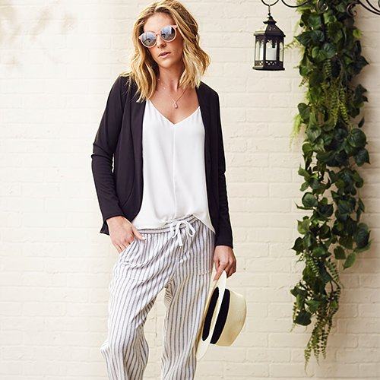
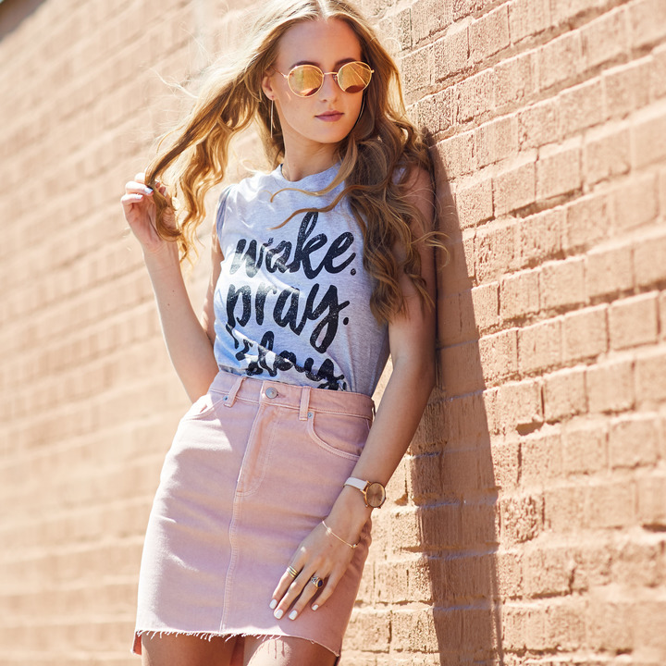
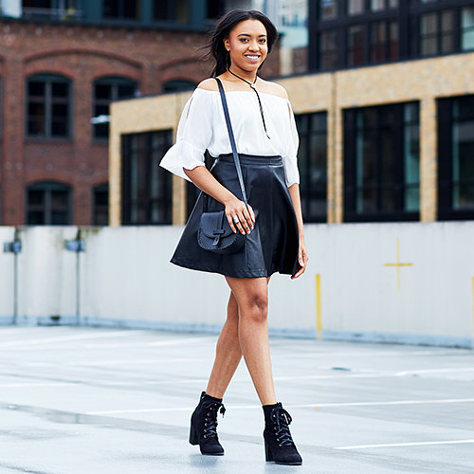
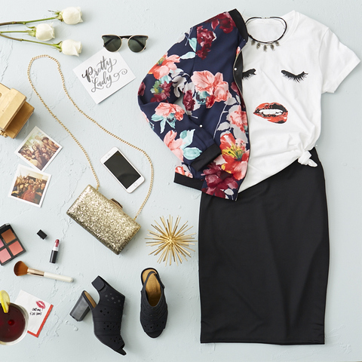
Women’s Department
Studio Glossary: Women’s Category
4
Blogger Style
Blogger Style Definition: Street style, trendy, girl on the go, playfully accessorized (including hats, sunnies, etc.), with a coffee or cell phone in hand. Possible HMU: tousled waves, subtle contouring and highlighting, trendy makeup.
Brand Reference: fast fashion including F21, Zara, Asos, Nasty Gal. Target, etc.

Slide 6
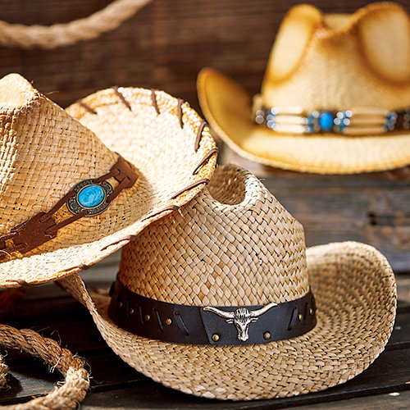
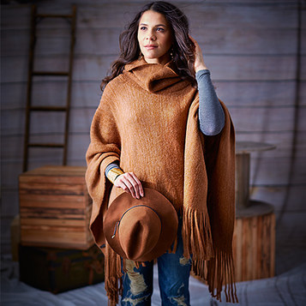
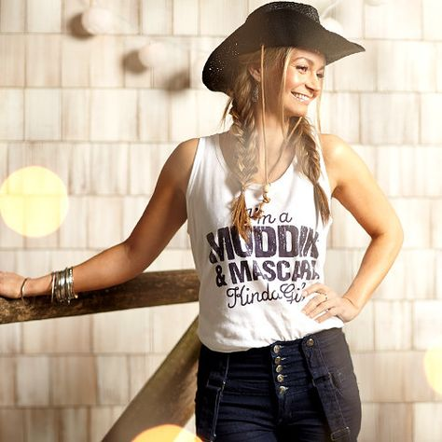
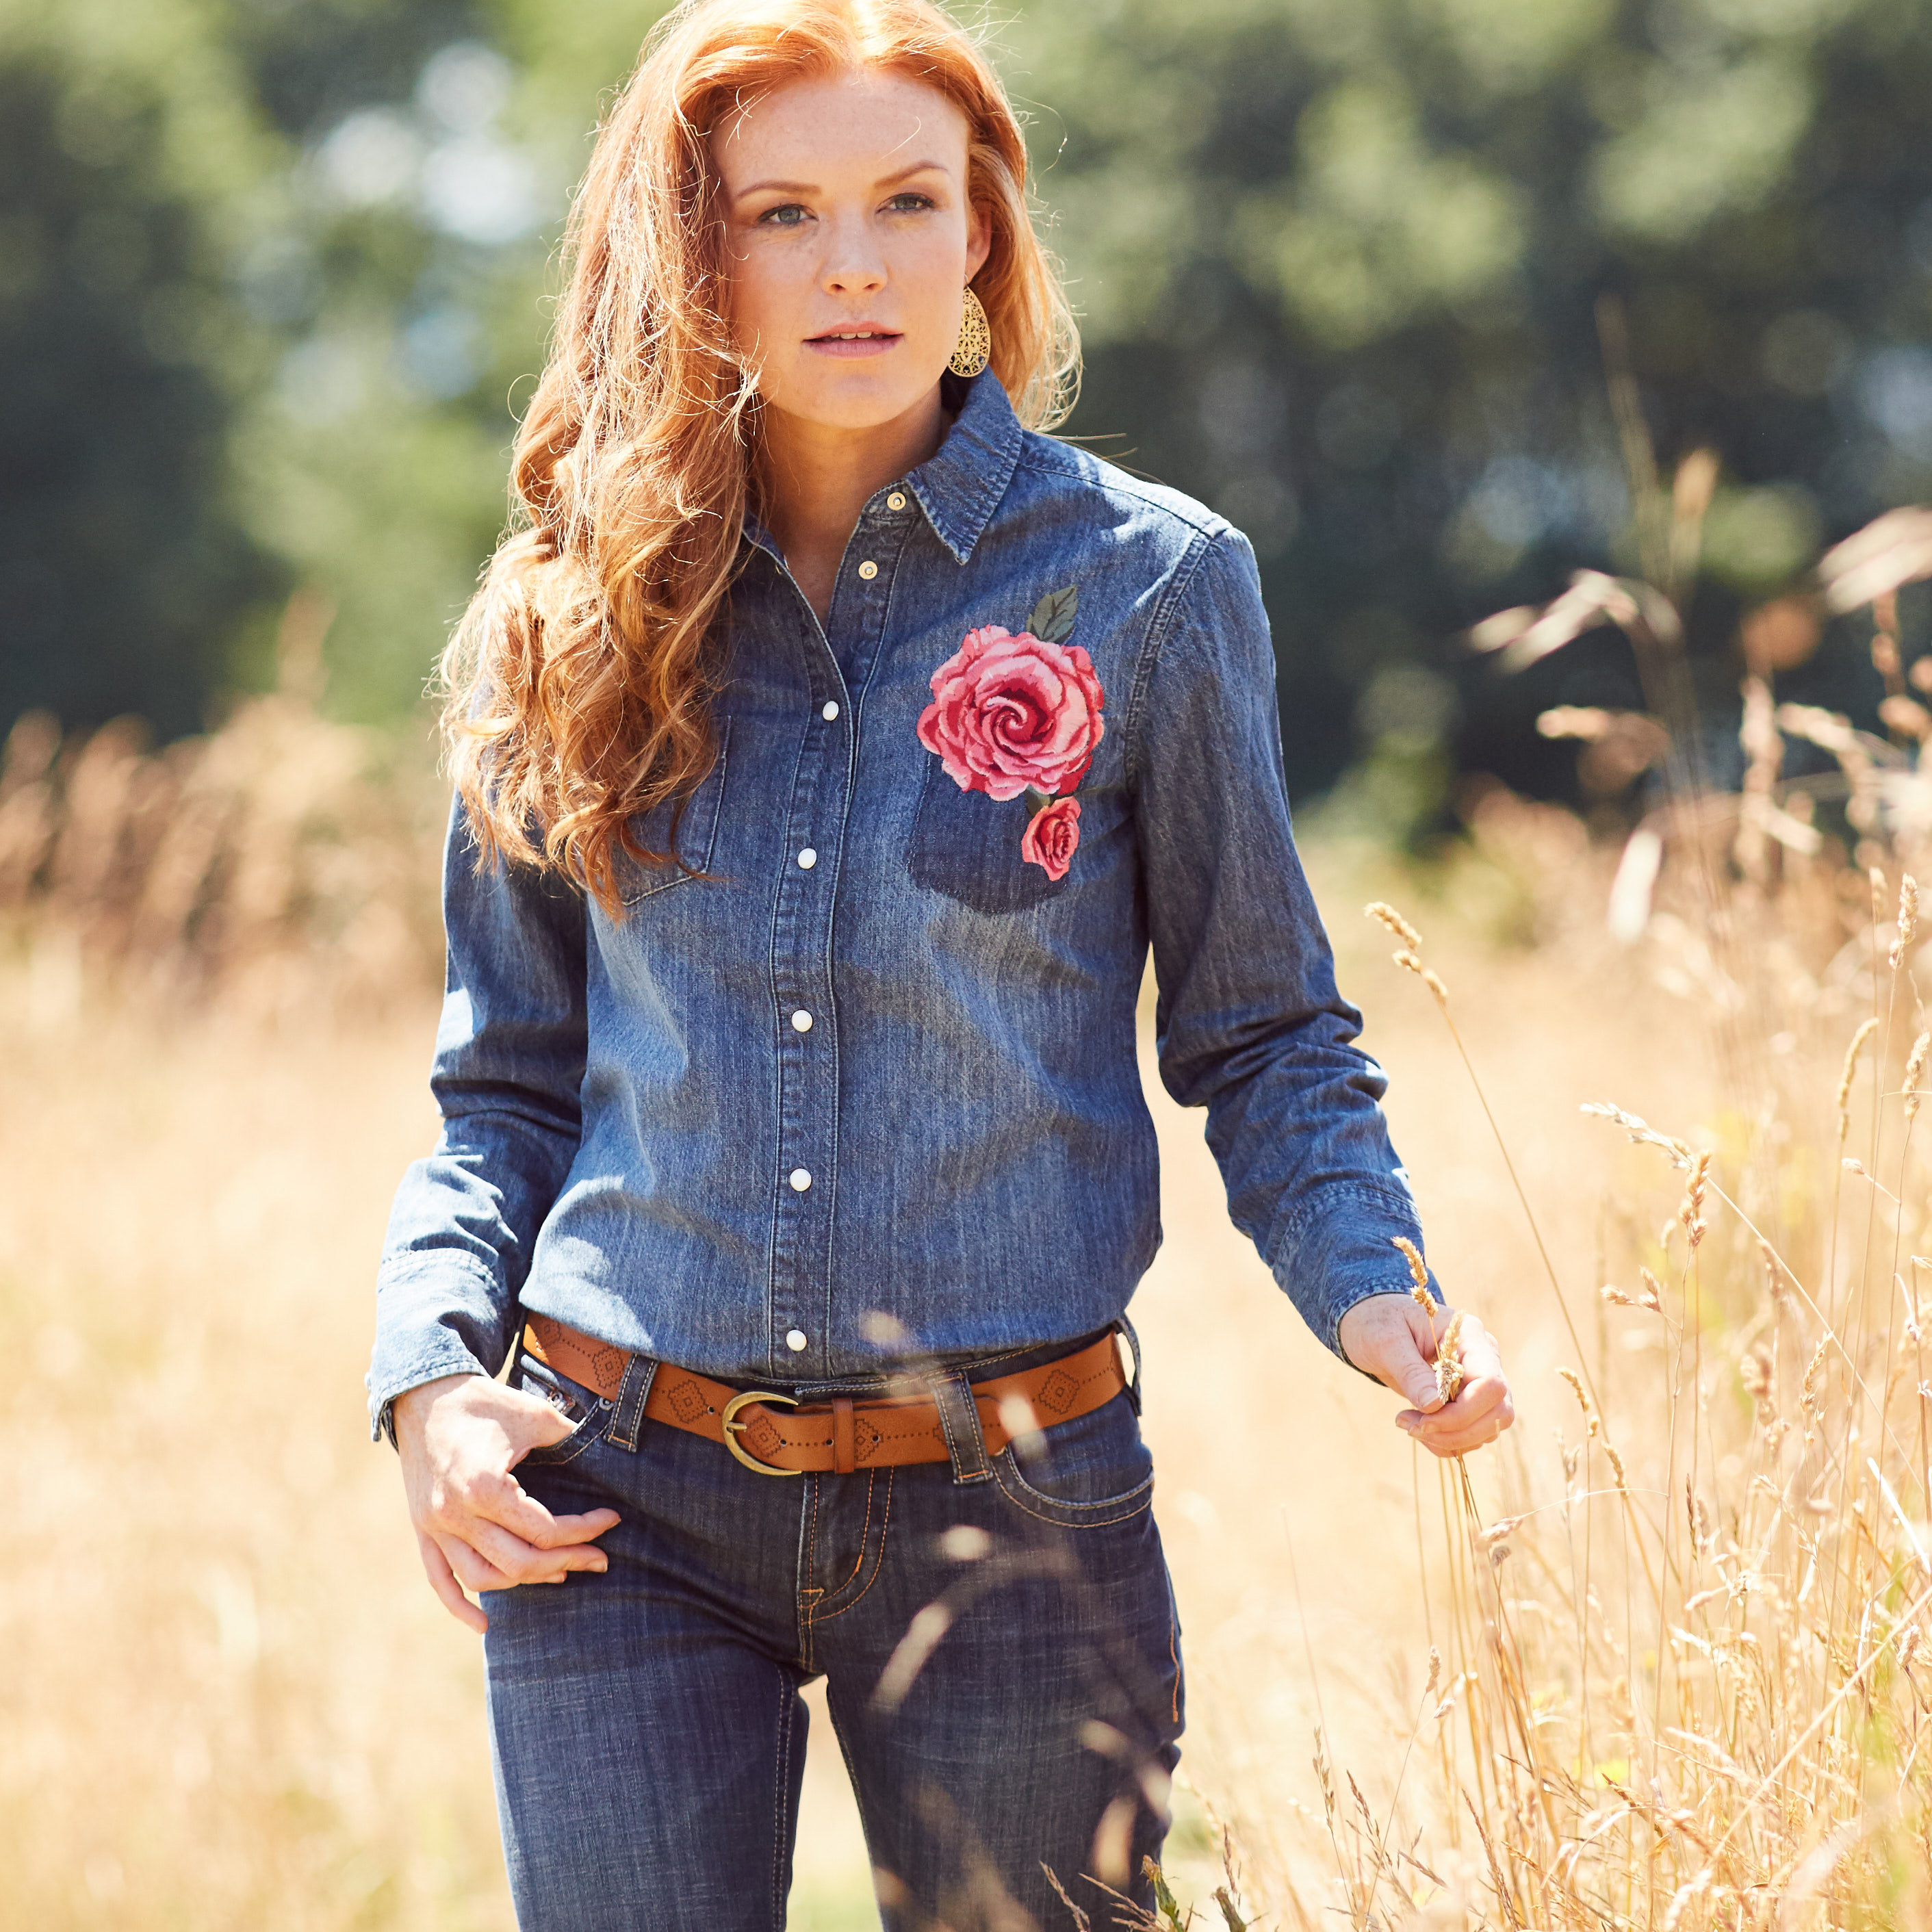
Women’s Department
Studio Glossary: Women’s Category
7
Western
Western Definition: Cowboy-inspired, classic styles, Canadian tuxedo. Accessories and elements may include paisley, scarf neck-tie, cowboy hat, leather boots, tassels. Possible HMU: clean face, hair with volume and curls.
Brand Reference: Wrangler, Sundance, Ralph Lauren

Slide 7
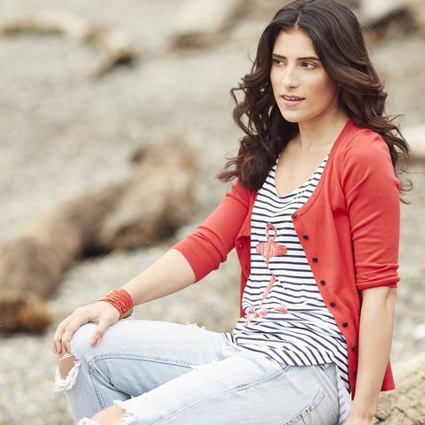
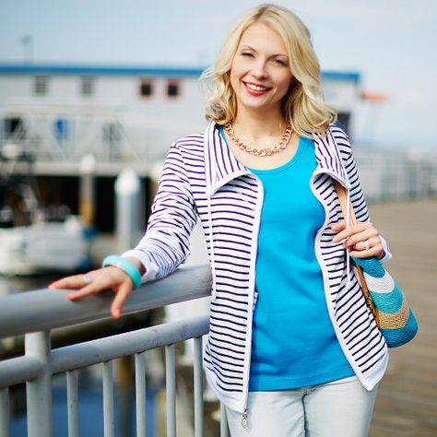
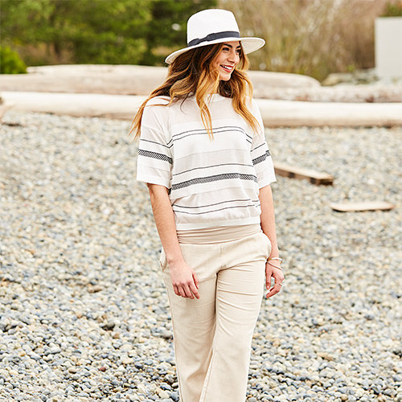
Women’s Department
Studio Glossary: Women’s Category
5
Nautical
Nautical Definition: Vertical blue and white stripes with red accents with a preppy, All American feel; may include khaki, cardigans, denim, flats, boat shoes, hats, double breasted peacoat. Possible HMU: Red lip, cat eye, flawless skin.
Brand Reference: Nautica, J. Crew, Sperry, Ralph Lauren

Slide 8
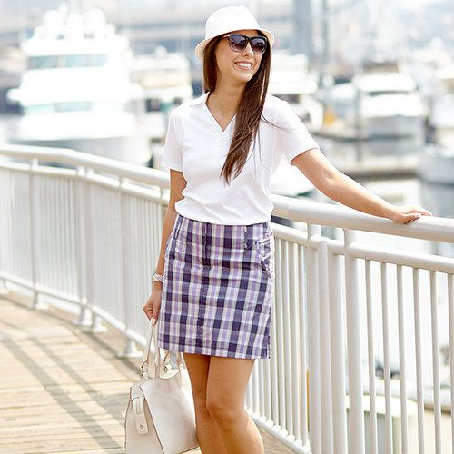
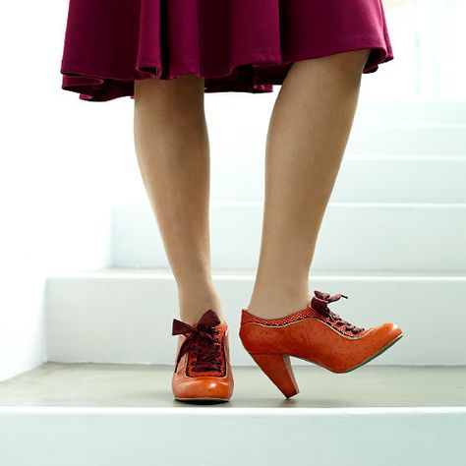
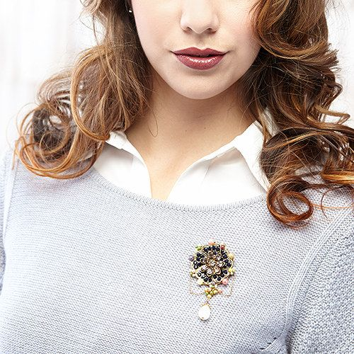
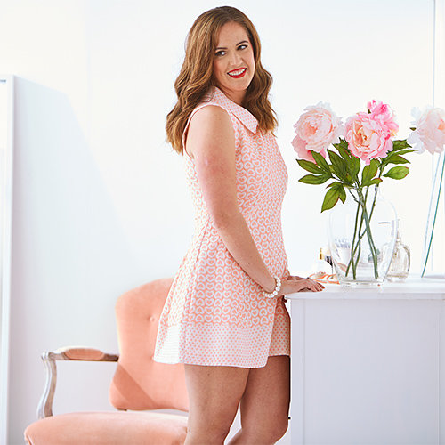
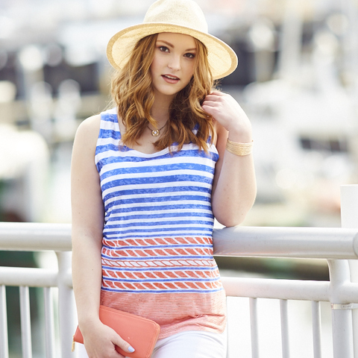
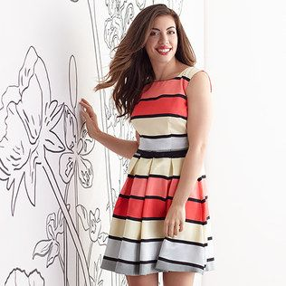
Women’s Department
Studio Glossary: Women’s Category
6
Preppy
Preppy Definition: Tailored, polished, tucked in, high-waisted skirts and trousers, chinos, pleated skirts, sweaters layered over collared shirts, refined jewelry, penny loafers and boat shoes, with a nod towards the uniform and equestrian. Possible HMU: glowing skin, headbands, ponytails, side part.
Brand Reference Kate Spade, J. Crew, Tommy Hilfiger, Ted Baker

Slide 9
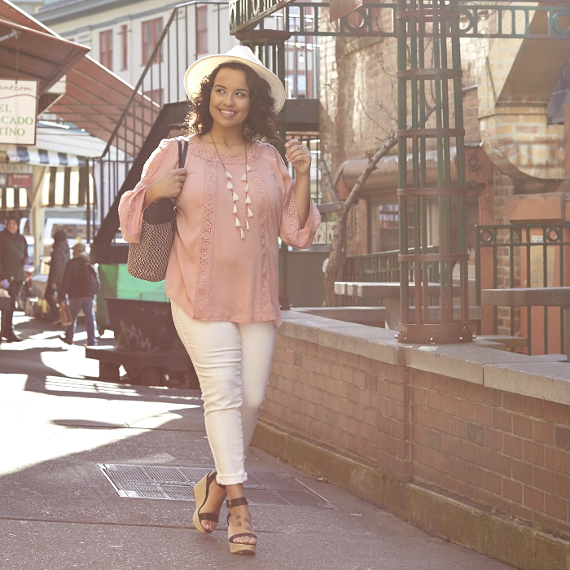
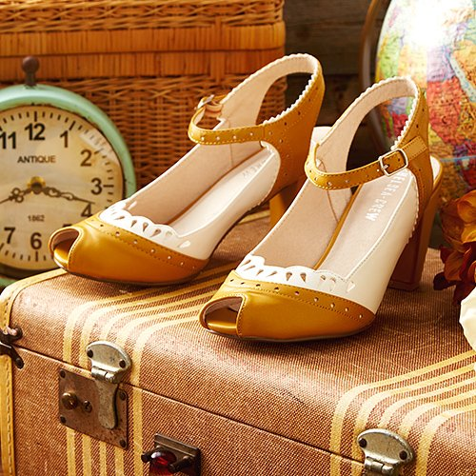
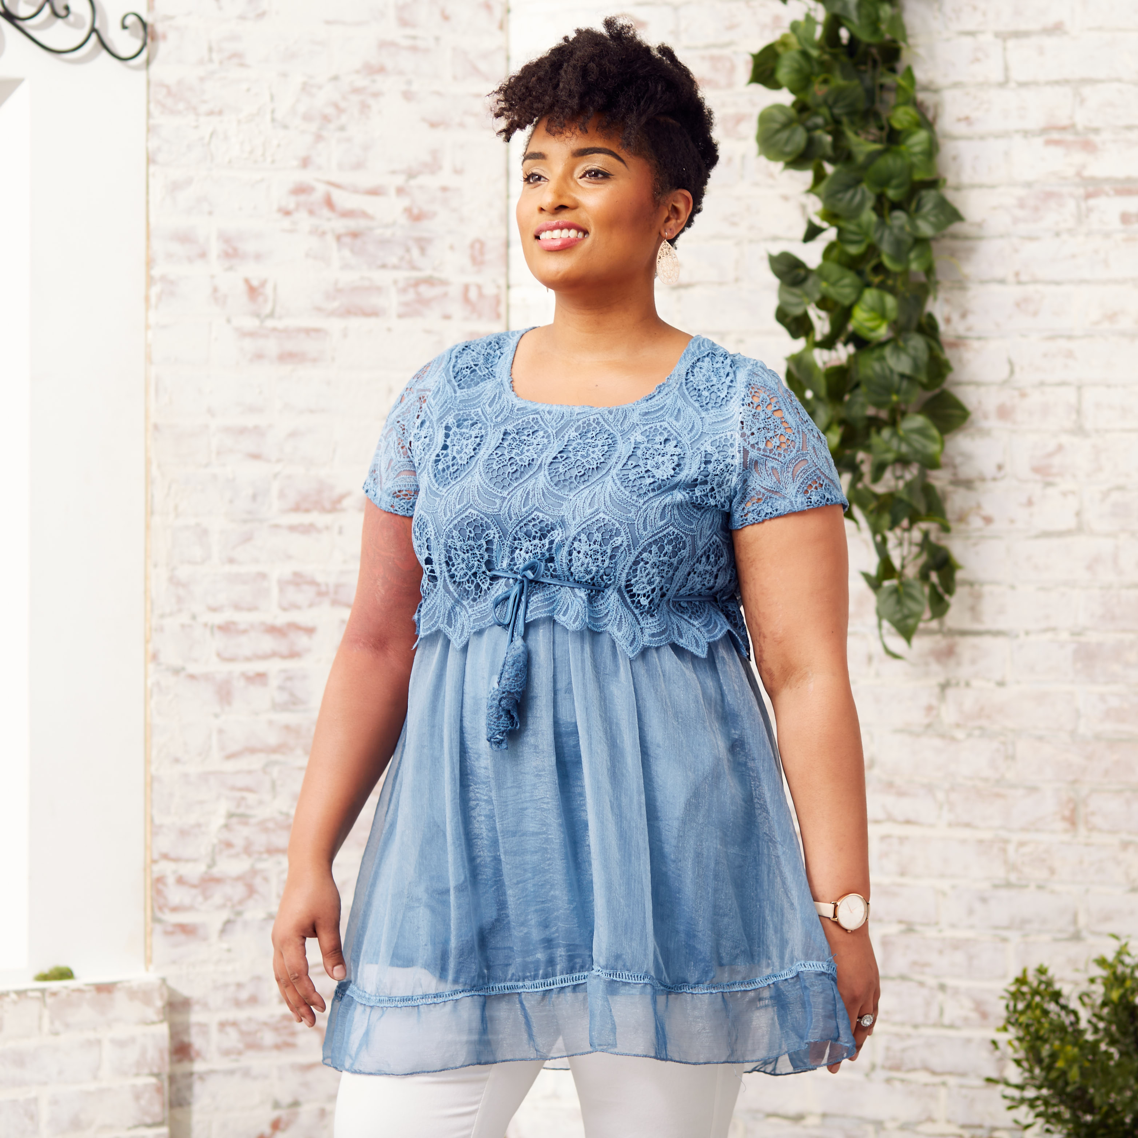
Women’s Department
Studio Glossary: Women’s Category
9
Shabby Chic
Shabby Chic Definition: Vintage, feminine, neutrals and pastels, English rose garden, lace, often loose fitting on the body. Weathered, white washed wood, white brick. Possible HMU: Soft curls, messy side bun.
Brand Reference Anthropologie, Pretty Angel

Slide 10
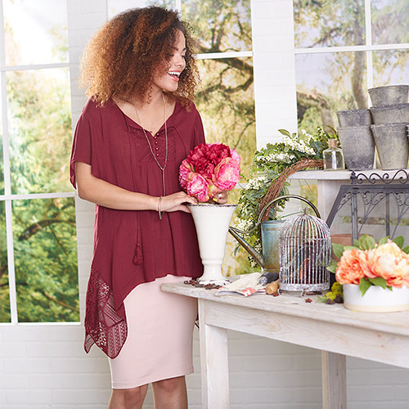
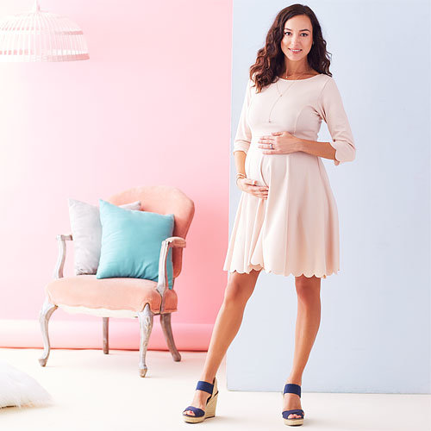
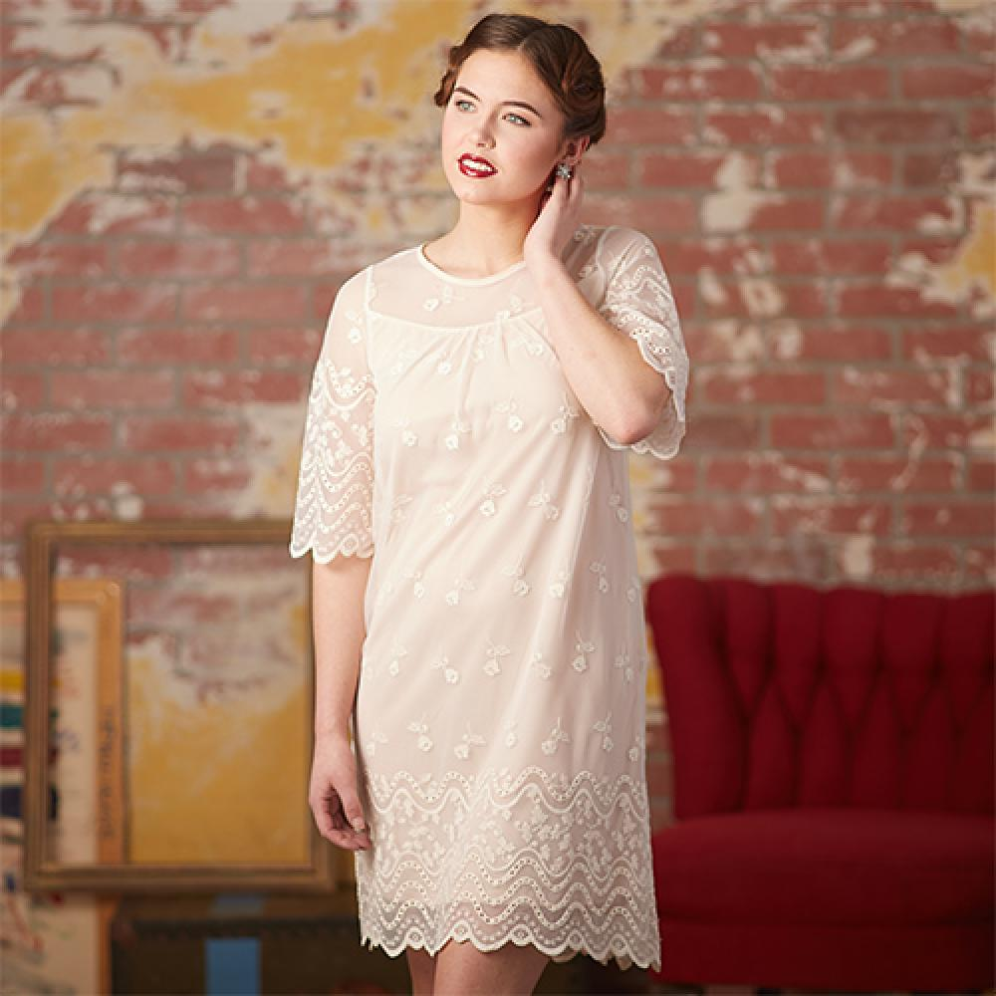
Women’s Department
Studio Glossary: Women’s Category
10
Feminine / Romantic
Feminine / Romantic Definition: Softer, pinks, white, laces, chiffon, delicate details, flowy. Possible HMU: Wavy and curly hair, loose braids, flushed cheeks, stained lips.
Brand Reference: For Love and Lemons, Lauren Conrad, Blush, Ralph Lauren

